Slide 1
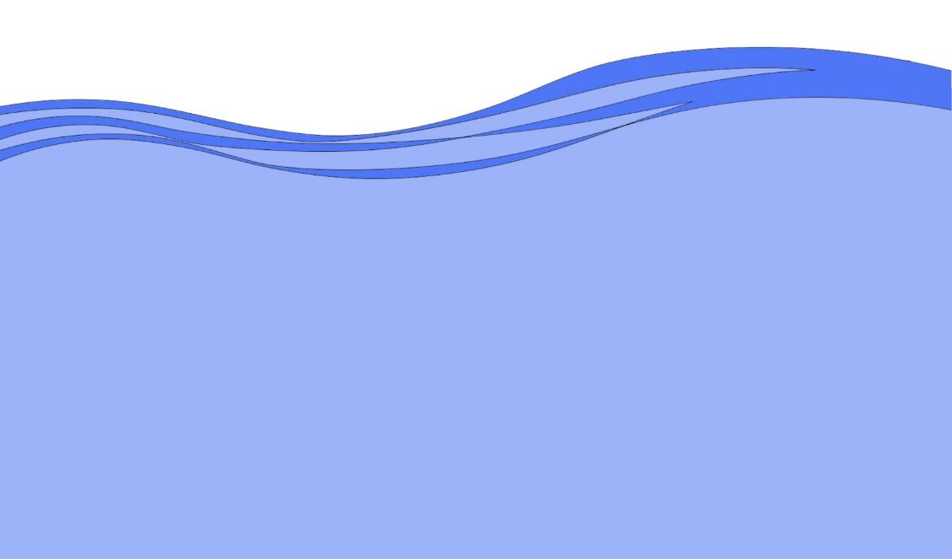
Horry County Government
Bucksport Community Flood Mitigation Meeting
Big Bull Landing Road Project
Cowford Swamp
December 8, 2022

Slide 2
Agenda
- Introductions
- Past Flooding in Bucksport and Causes
- Flood Mitigation Project Progression
- Funding Source for the Project
- Design and Engineering Overview
- Review Recent Concerns from Public Comment
- Comments/Questions
Notes:
Thom Roth Andy Markunas

Slide 3
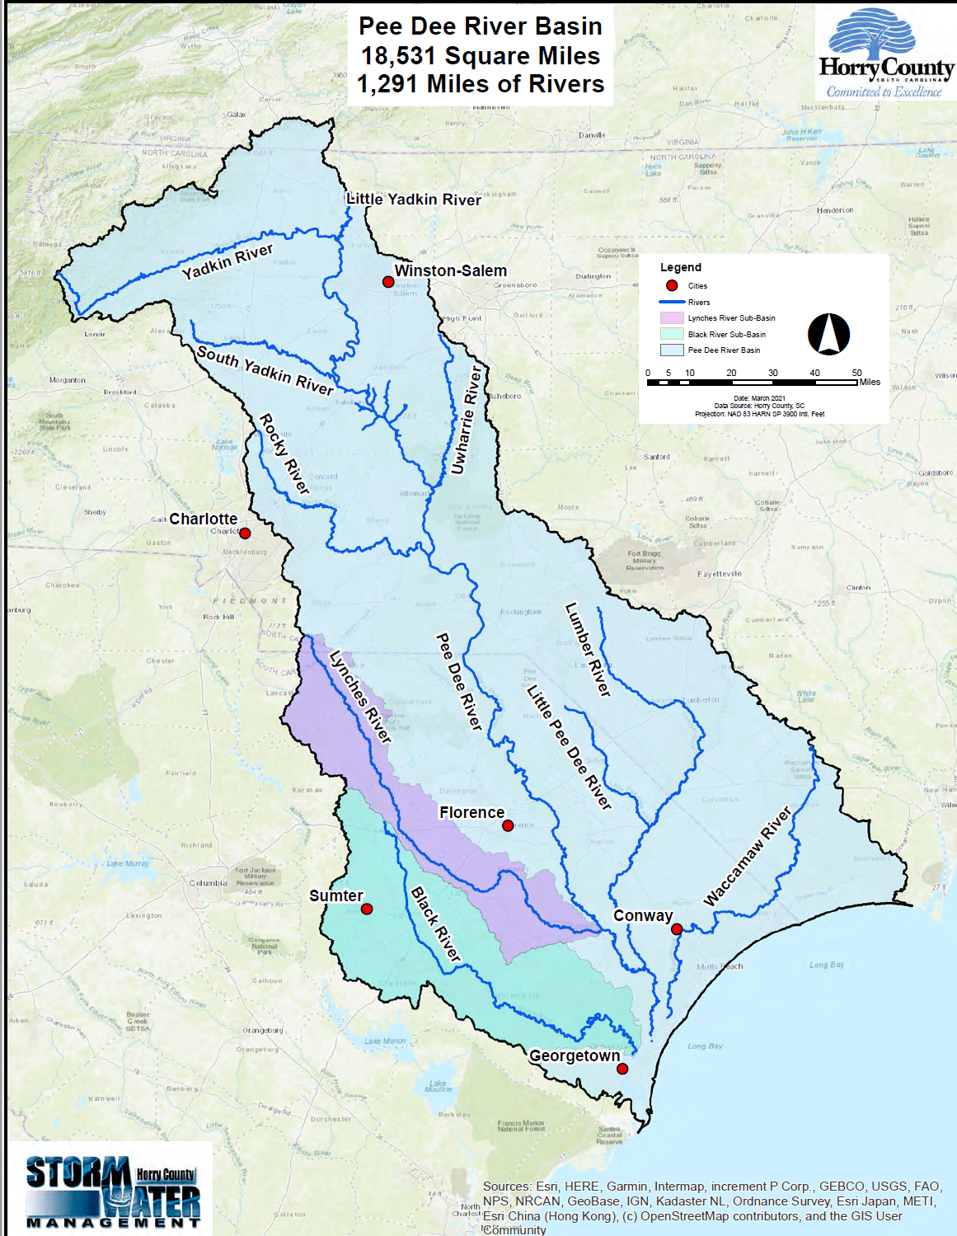
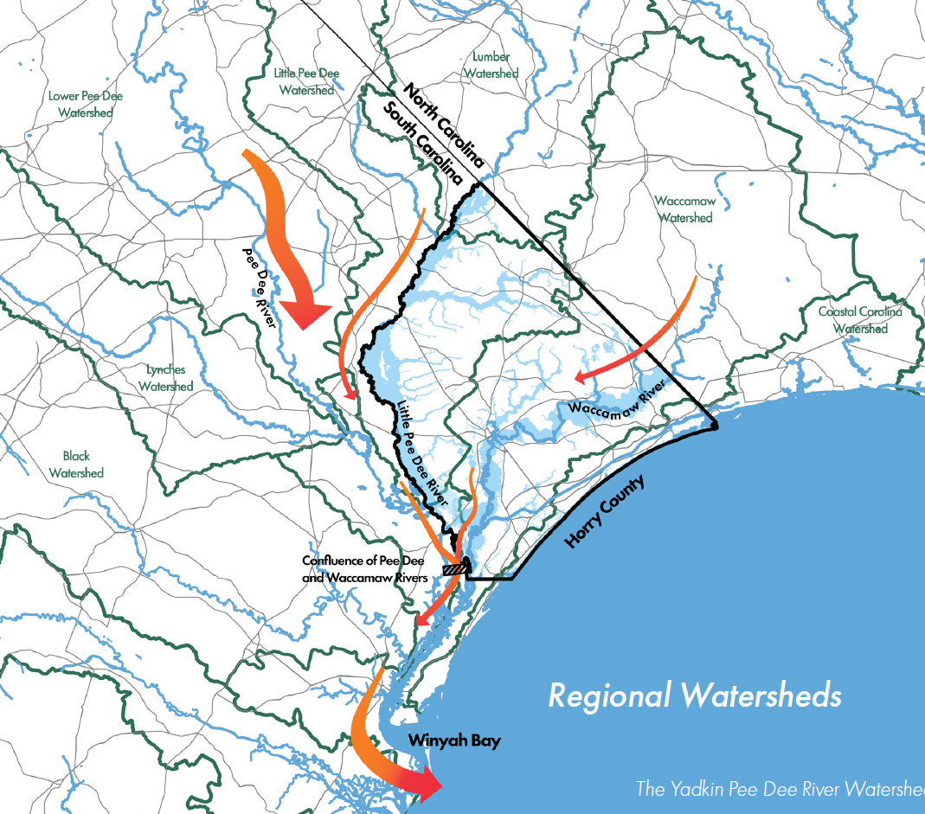
Bucksport
Bucksport
Notes:
Thom Roth

Slide 4
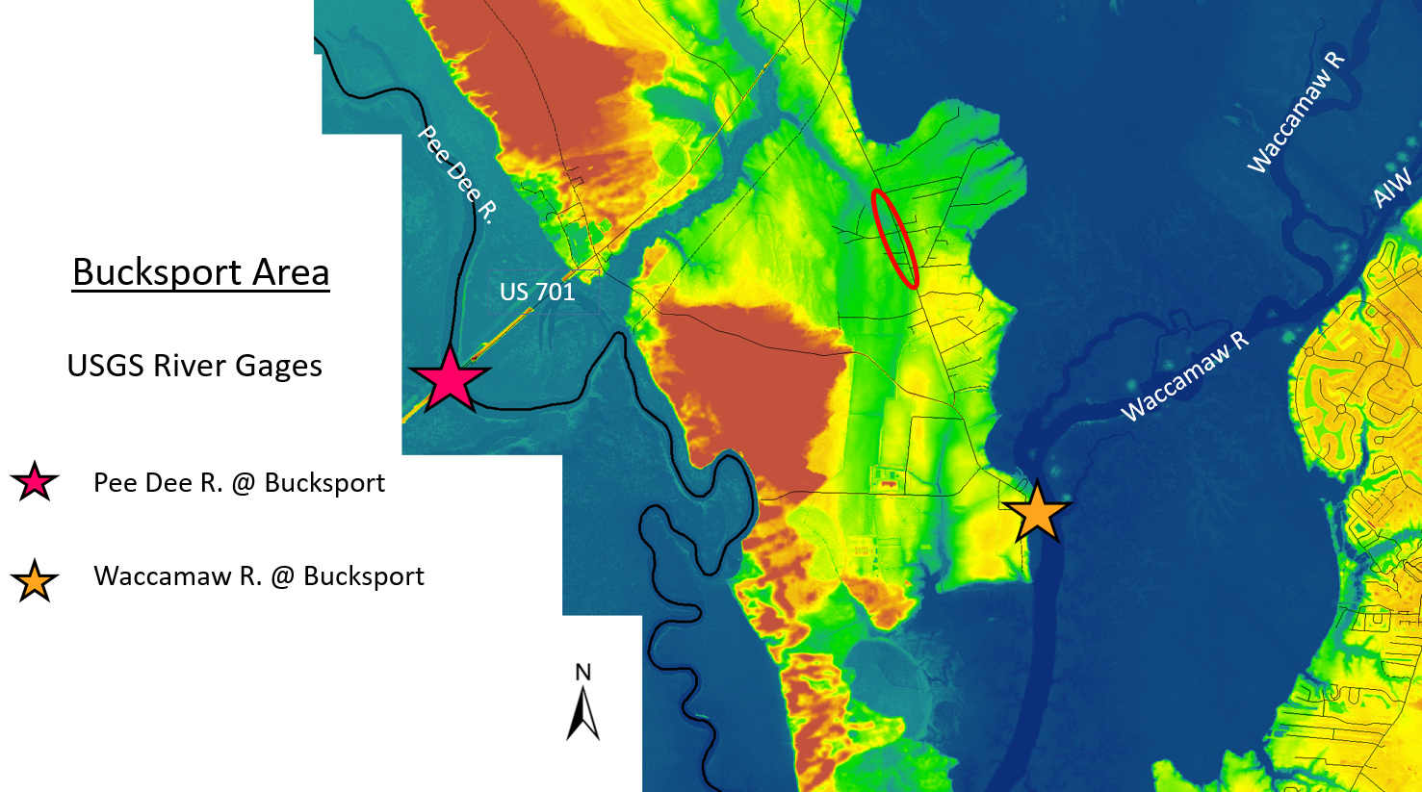
Notes:
Thom Roth

Slide 5
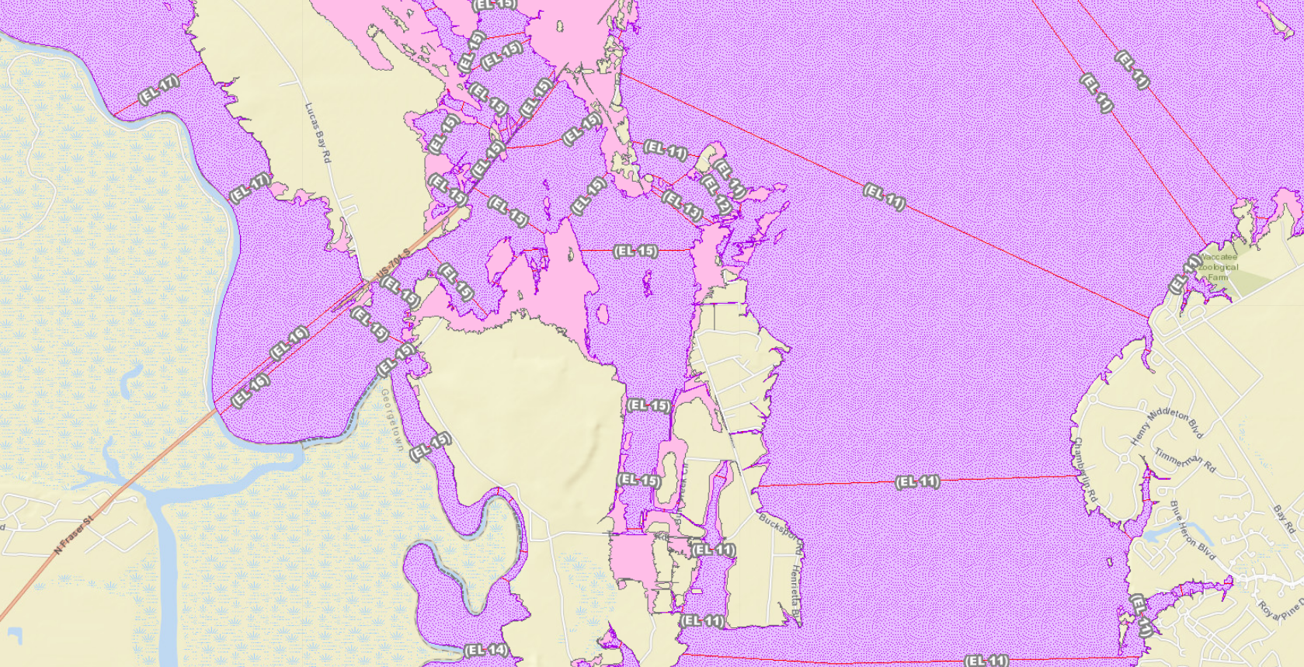
FEMA Flood Elevations
Pee Dee River
Cowford Swamp
Waccamaw River
Notes:
Thom Roth

Slide 6
Cowford Swamp Flow
Normal Storm Event
Riverine – Backwater Flood
Notes:
Thom Roth

Slide 7
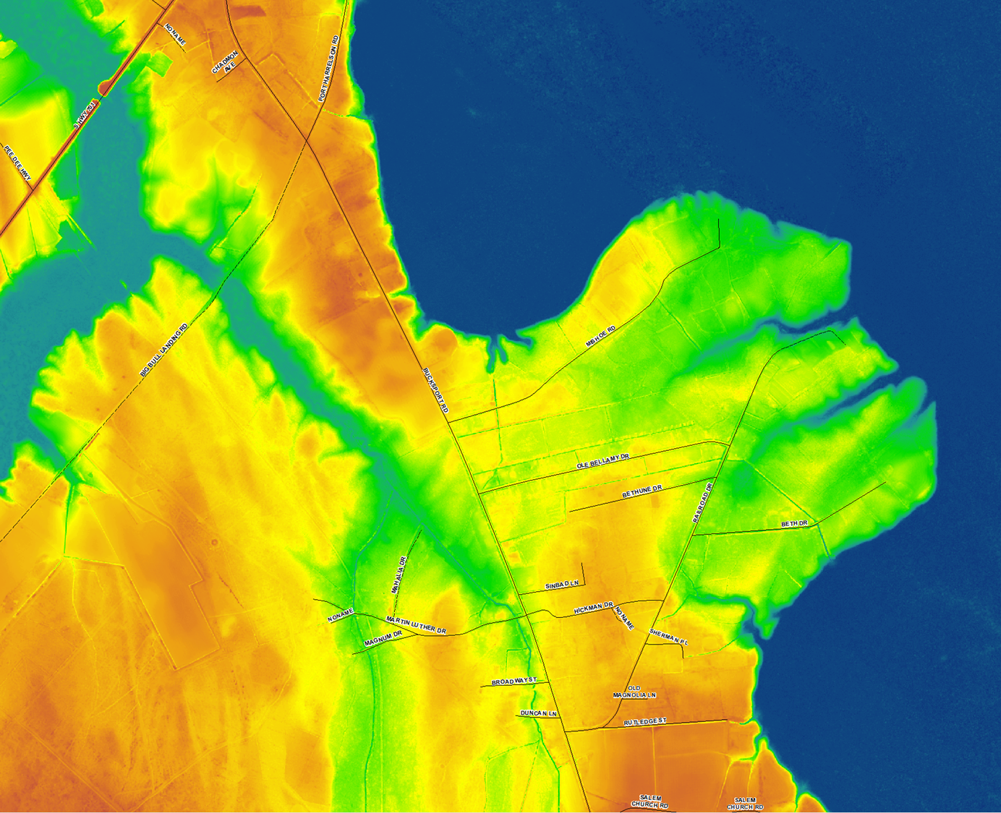
Bucksport Area Riverine (Backwater) Flood Flows - Current
Notes:
Thom Roth

Slide 8
Bucksport Area Riverine (Backwater) Flood Flows – Proposed (after project)
Overflow channel designed to handle local storm runoff during a river flooding event only when drainage outfall under Big Bull Landing Road is closed (temporarily).
Notes:
Thom Roth

Slide 9
Grant Information
Funder: U.S. Department of Housing & Urban Development (HUD)
Program: Community Development Block Grant – Mitigation (CDBG-MIT)
State Recipient: SC Office of Resilience
Subrecipient: Horry County
Grant Funding: Big Bull Landing Road Raising: $893,750
Grant Funding: Cowford Swamp Tributary Channel: $1,582,500
Notes:
Thom Roth

Slide 10
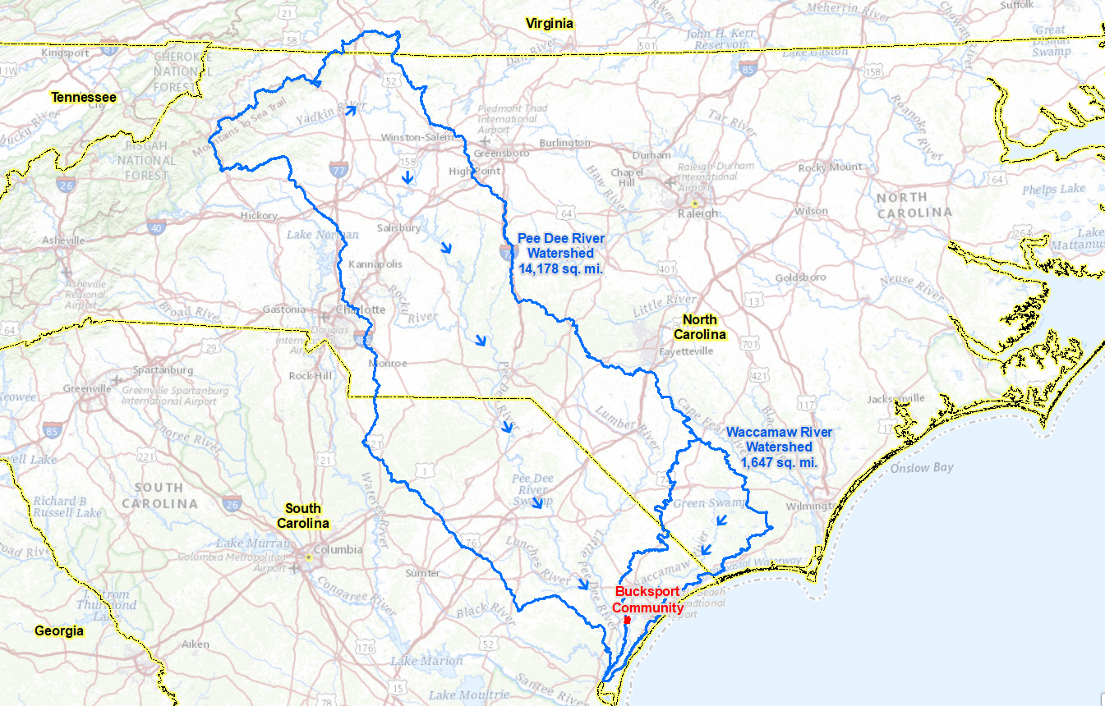
PEE DEE RIVER AND
WACCAMAW RIVER WATERSHEDS
Notes:
Waccamaw River Watershed 1/10 the size of the Pee Dee River Watershed
Rick Karkowski

Slide 11
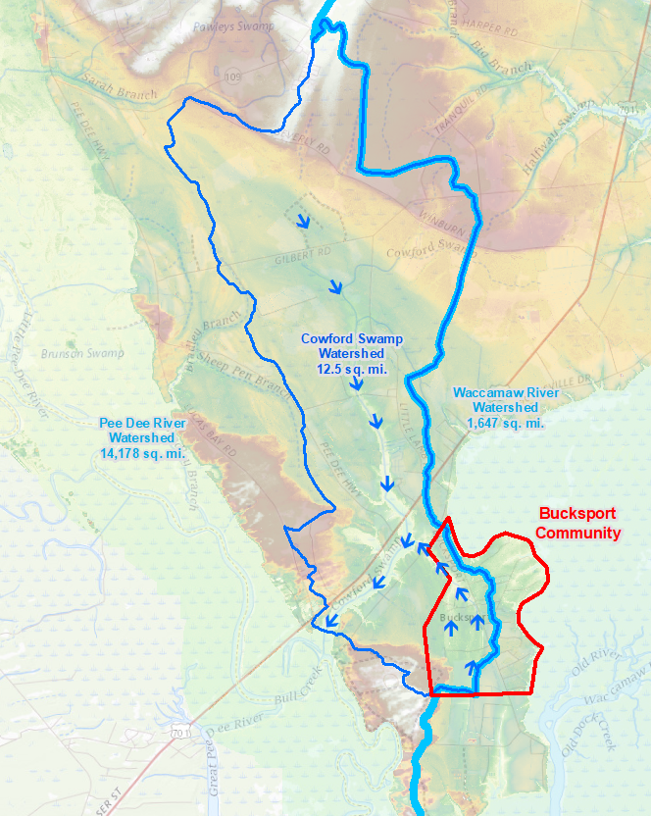
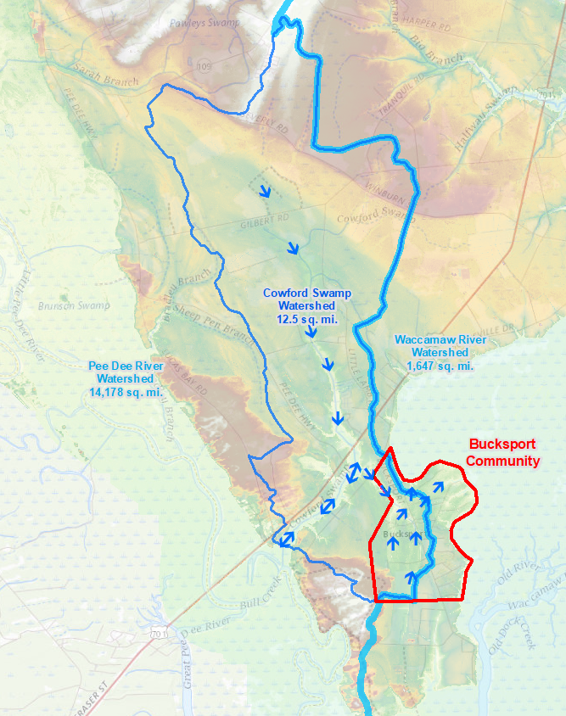
Normal
Flow Condition
Pee Dee River Backwater
Flooding Condition
Notes:
Rick Karkowski

Slide 12
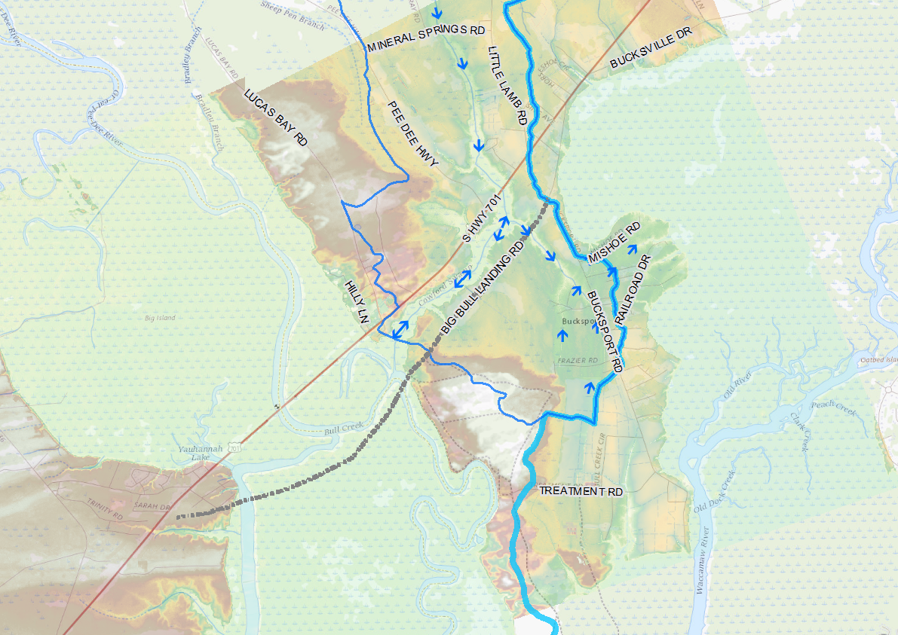
Pee Dee River Backwater
Flooding Condition
Project Area
Flow Cross Section
Notes:
Rick Karkowski

Slide 13
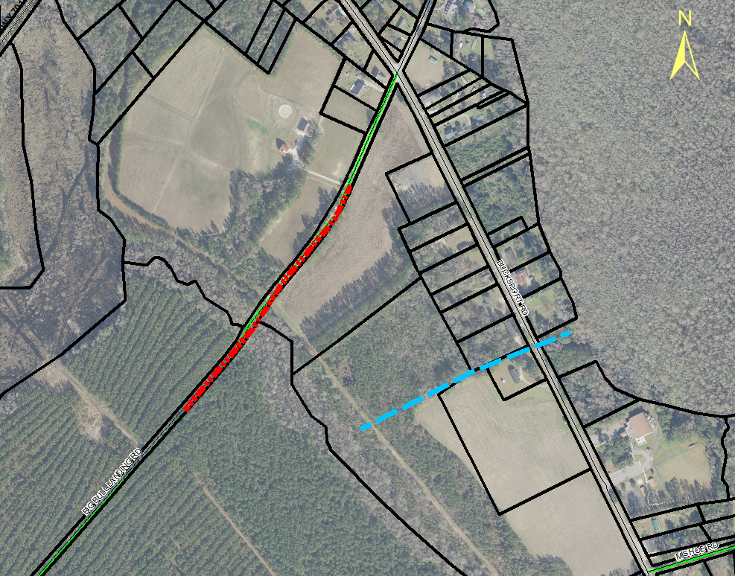
Big Bull Landing Road Raising and Bucksport Relief Channel
Create relief channel to allow for drainage when the crossing under Big Bull Landing is closed
Raise Big Bull Landing Road approximately 2700 ft long and 7-8 feet high at it’s lowest point. The entire road will not be raised, just the portion in red.
Notes:
Rick Karkowski

Slide 14
Big Bull Landing Road – Flood Elevations
Hurricane Florence
Elevation 16
Overtops Existing & Raised Road
Height
Big Bull (Proposed)- 15.0
Hurricane Matthew
Elevation 13.6
Overtops Existing Road Height
Bucksport
Juaquin Flood Event
Elevation 10.7
Overtops Existing Road Height
Big Bull (Existing)- 8.0
PIPE
Notes:
Rick Karkowski

Slide 15
Big Bull Landing Road – Flood Elevations
Hurricane Florence - 16.1
Big Bull (Proposed)- 15.0
Hurricane Matthew – 13.6
TS Joaquin 10.7
Big Bull (Existing)- 8.0
PIPE
Notes:
Rick Karkowski

Slide 16
Big Bull Landing Road Without Project
Bucksport
PIPE
Notes:
Rick Karkowski

Slide 17
Big Bull Landing Road With Project
Protects Bucksport for Flood Event up to Elevation of 15-ft
Big Bull Landing Road
Bucksport
PIPE
Notes:
Rick Karkowski

Slide 18
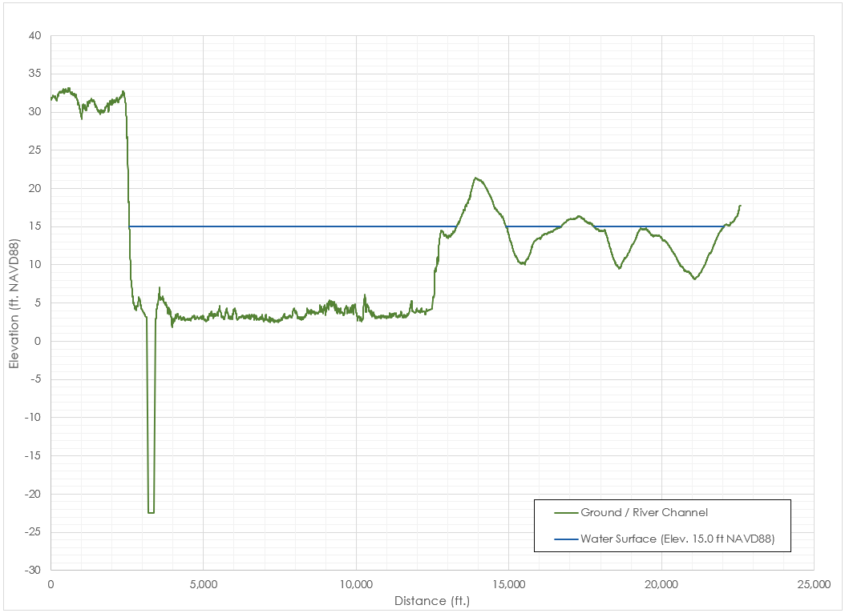
Pee Dee River Flood Flow Cross Section
At Big Bull Landing Road
Big Bull Landing Road
Project Area
Proposed Area of Fill
Main Flow Area
120,300 sq. ft.
Blocked Area
8,590 sq. ft.
Ineffective Flow Area
Ineffective Flow Area
Notes:
Slide is Hidden. To
Rick Karkowski
be used if needed.

Slide 19
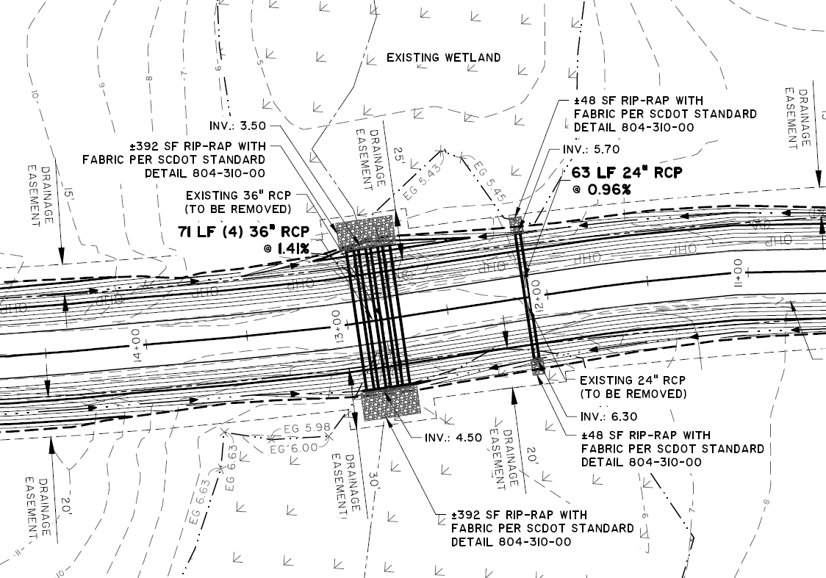
Big Bull Landing Road Improvements
Notes:
Rick Karkowski

Slide 20
Big Bull Landing Road Improvements
Local Drainage Maintained By Swales
Notes:
Rick Karkowski

Slide 21
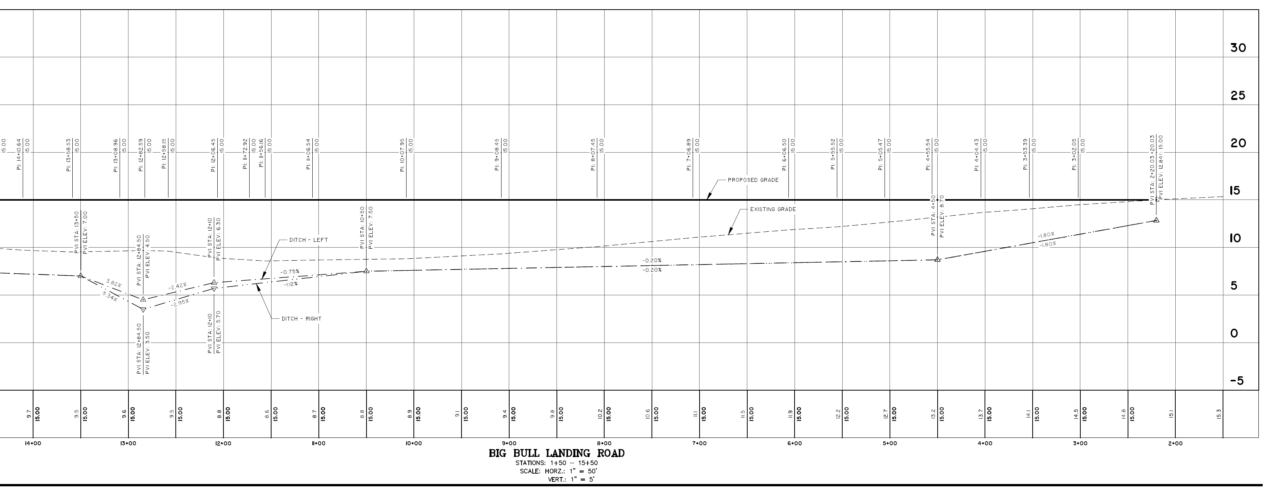
Big Bull Landing Road Improvements
Profile
Fill
Local Drainage Maintained By Swales
Notes:
Rick Karkowski

Slide 22
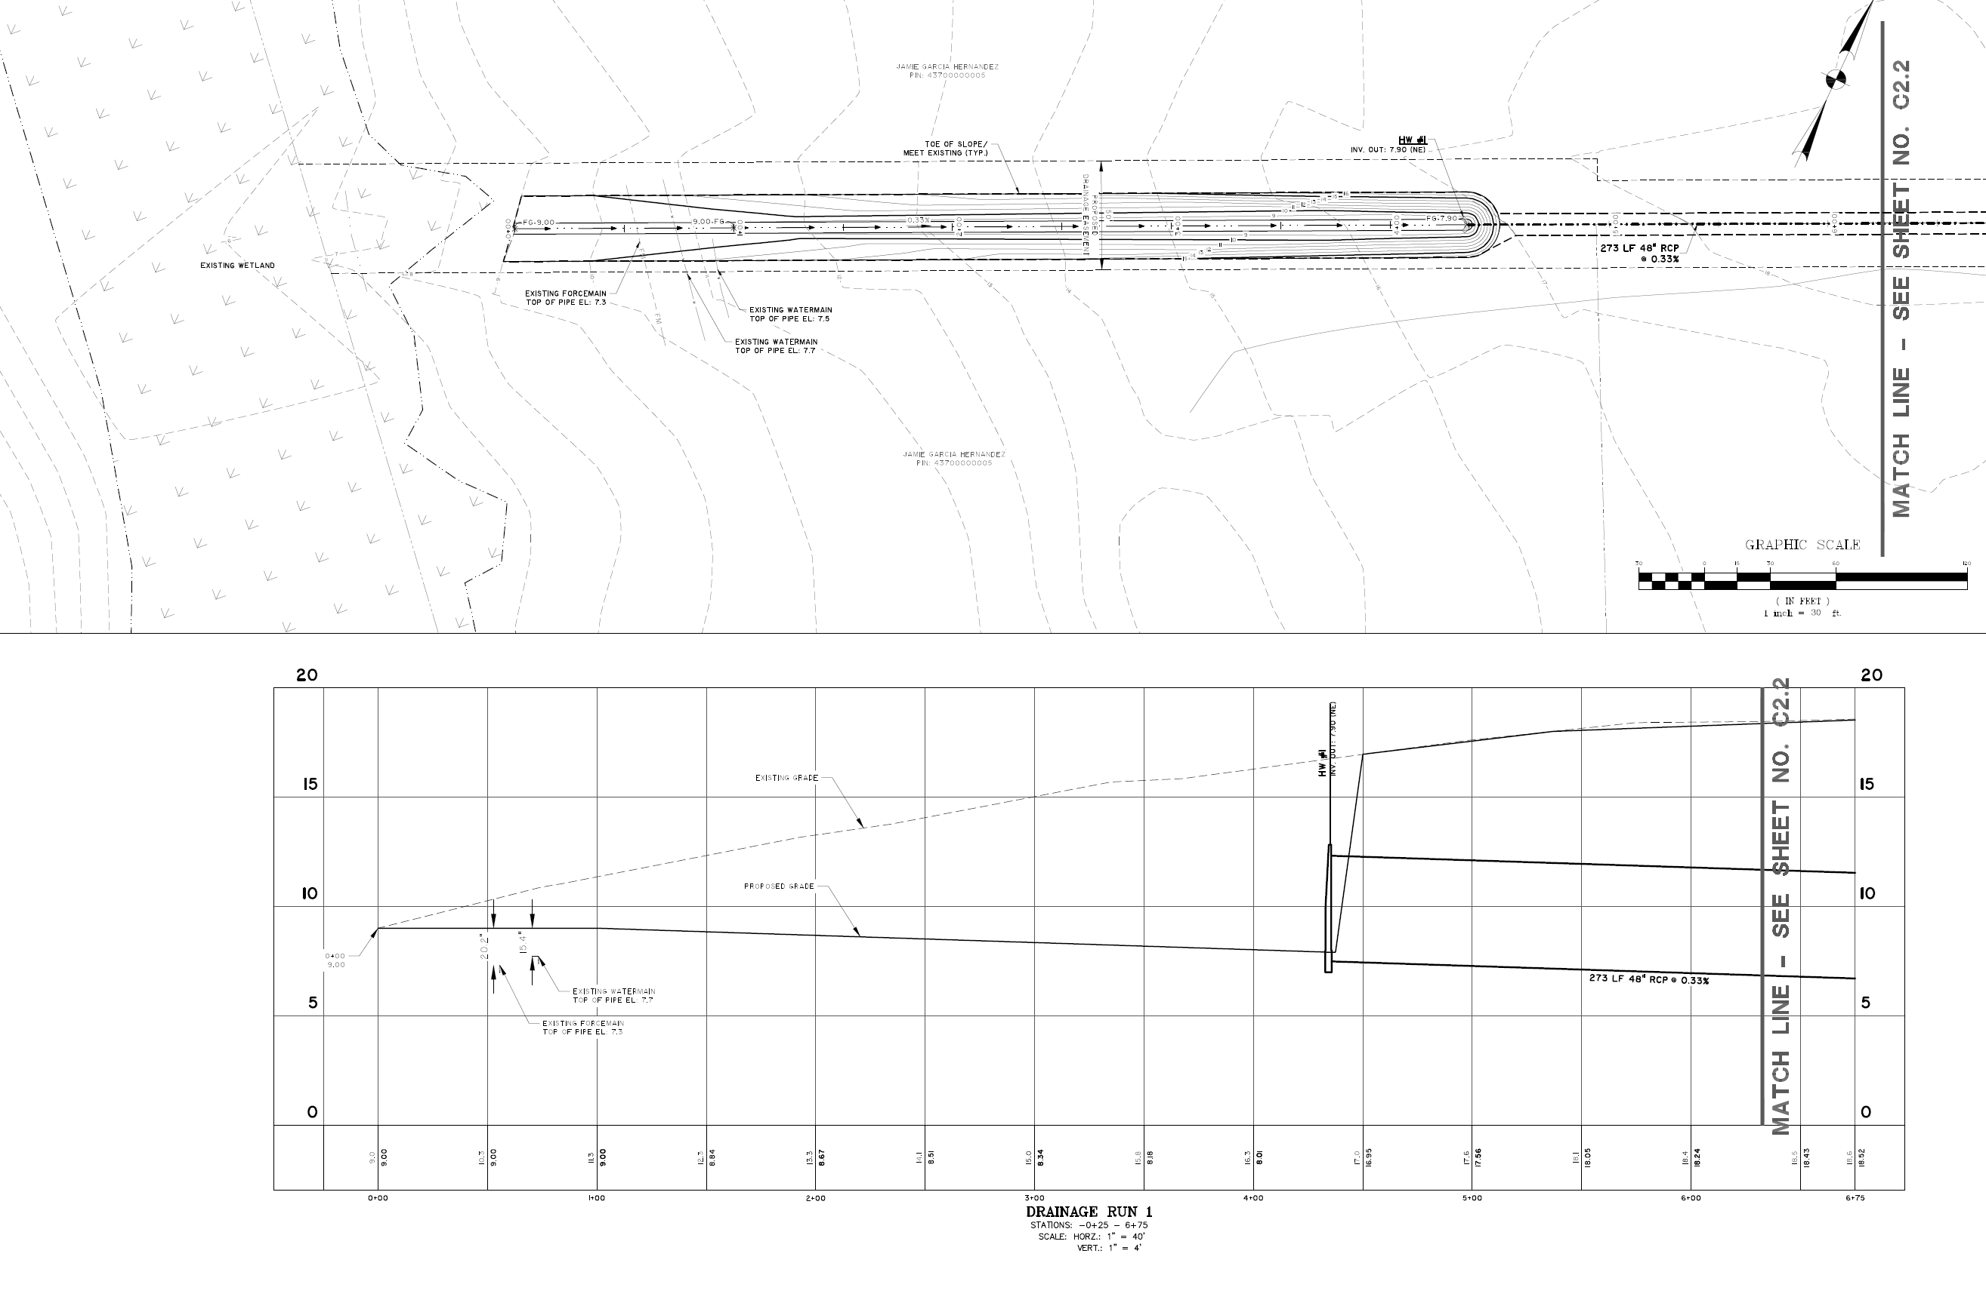
Bucksport Road Relief Channel (1 of 2)
No Wetland Impacts
Plan
Approximately 4.0 ft. above bottom of wetland
Invert 9.0 ft. NAVD 88
Profile
Notes:
Rick Karkowski

Slide 23
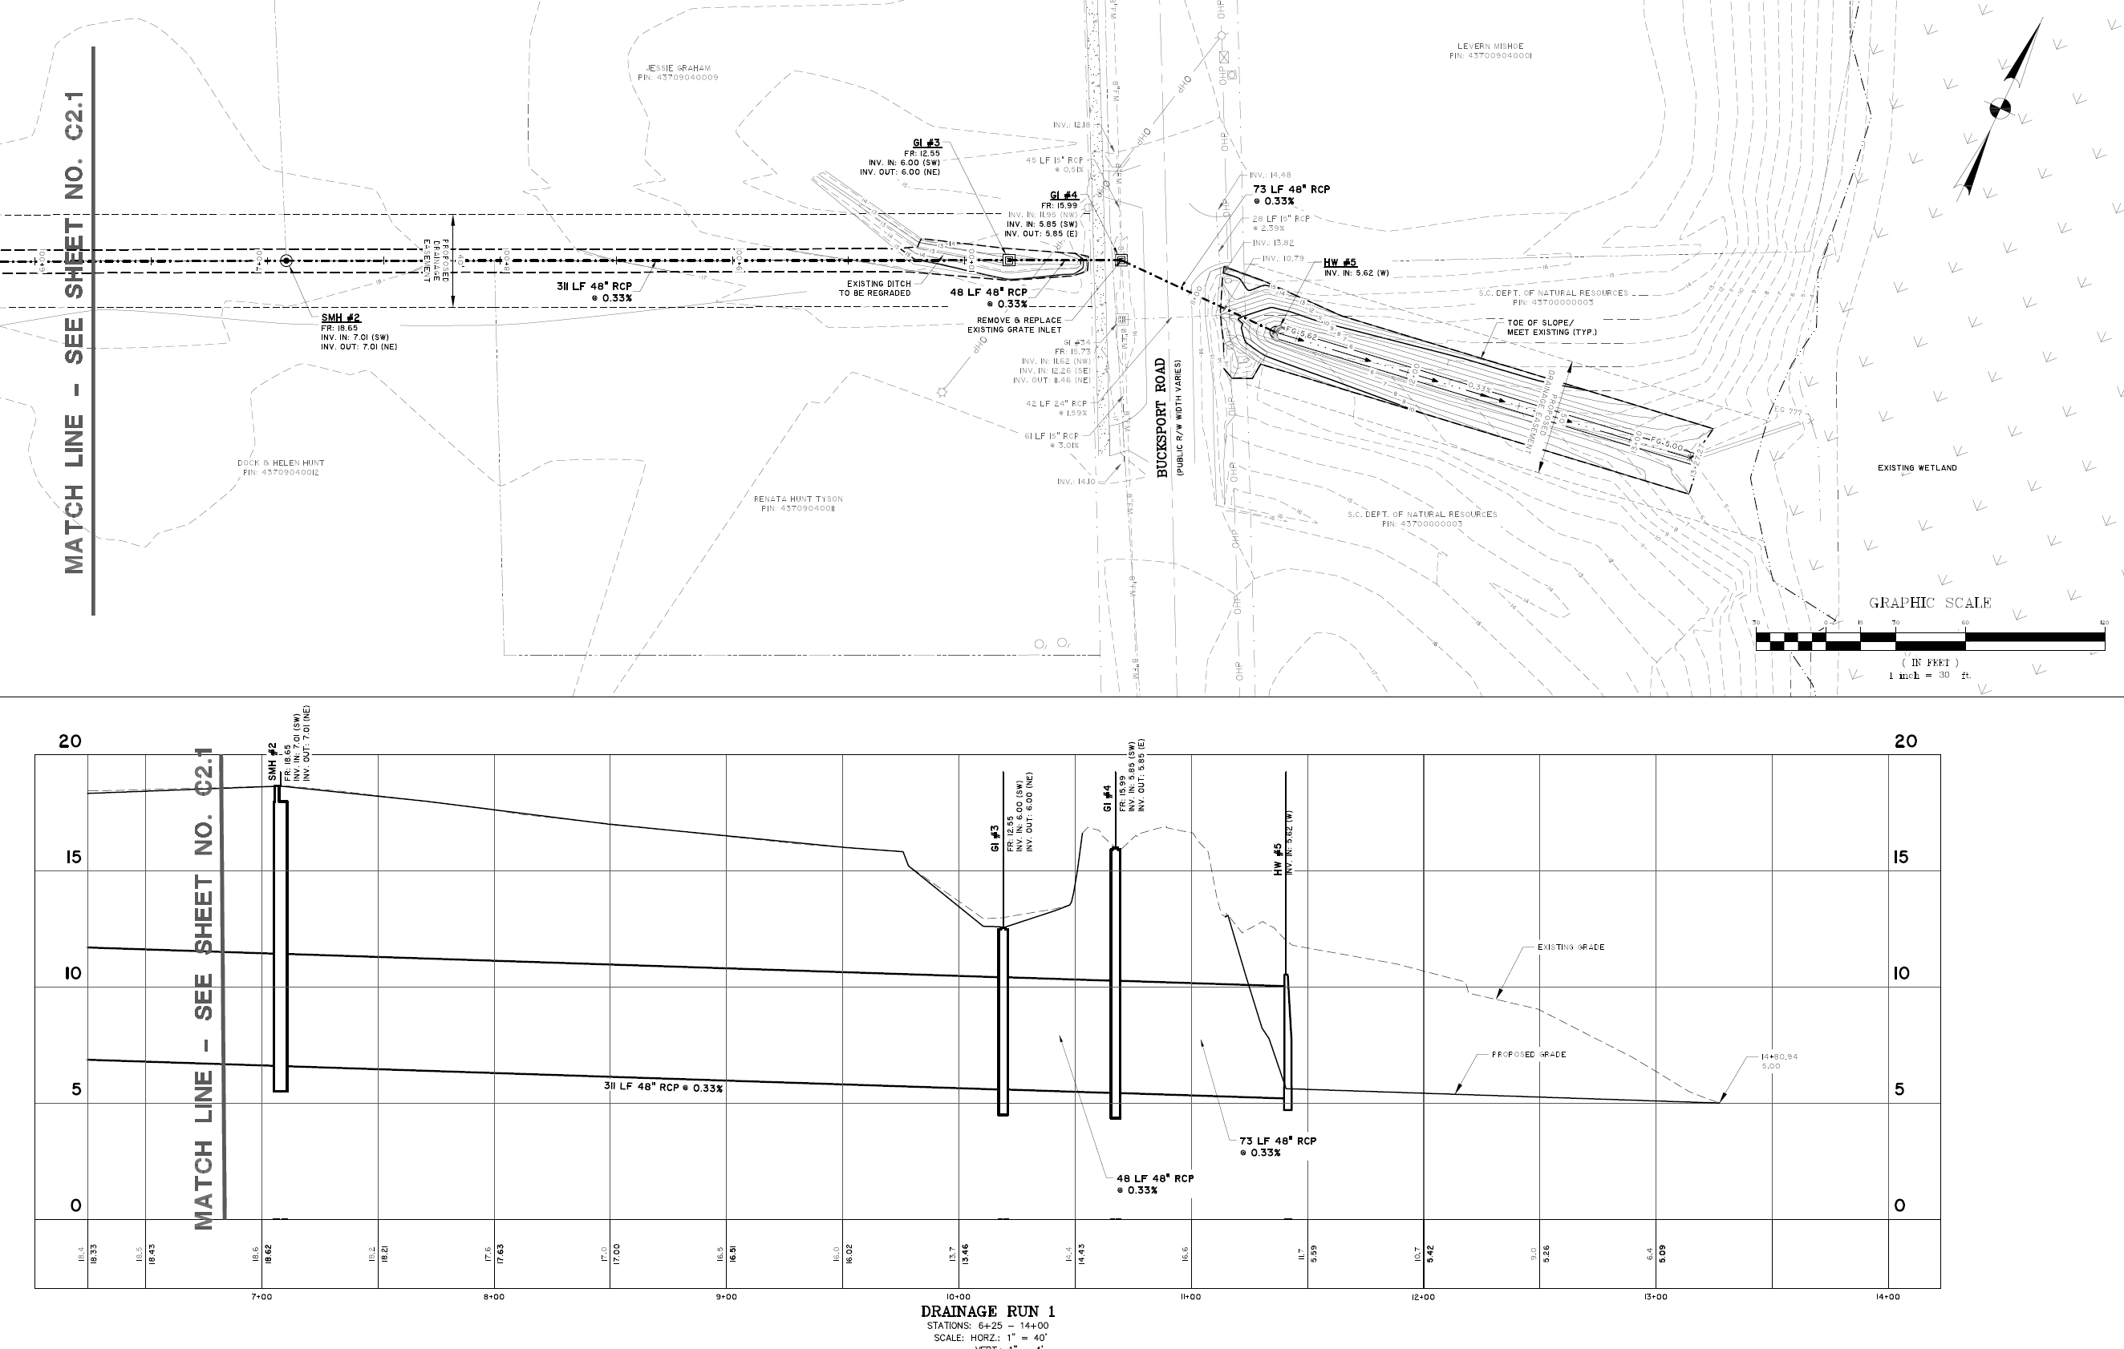
Bucksport Road Relief Channel (2 of 2)
Existing Outfall
Location
No Wetland Impacts
Plan
Rick Karkowski
Profile
Notes:
Rick Karkowski

Slide 24
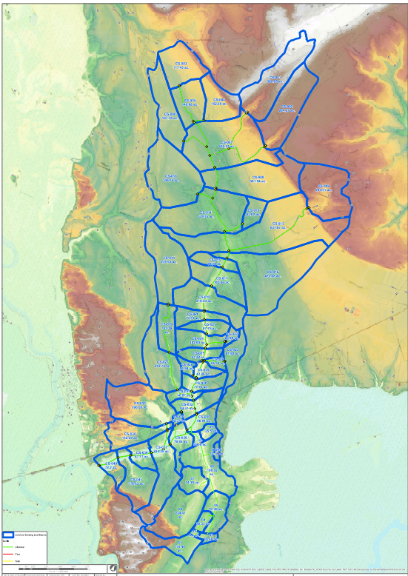
Engineering Analysis / Model Study
Full Cowford Swamp Watershed (12.5 sq. mi.)
Pre- and Post-Project Scenarios
Historic Hurricane Events (Rainfall / River Stages)
Joaquin (2015)
Matthew (2016)
Florence (2018)
Local Rainfall Flood Events
2-year (4.5 inches)
10-year (6.7 inches)
25-year (7.6 inches)
50 year (8.6 inches)
100-year (9.7 inches)
Rainfall
Pee Dee River Boundary
Waccamaw River Boundary
Notes:
Rick Karkowski

Slide 25
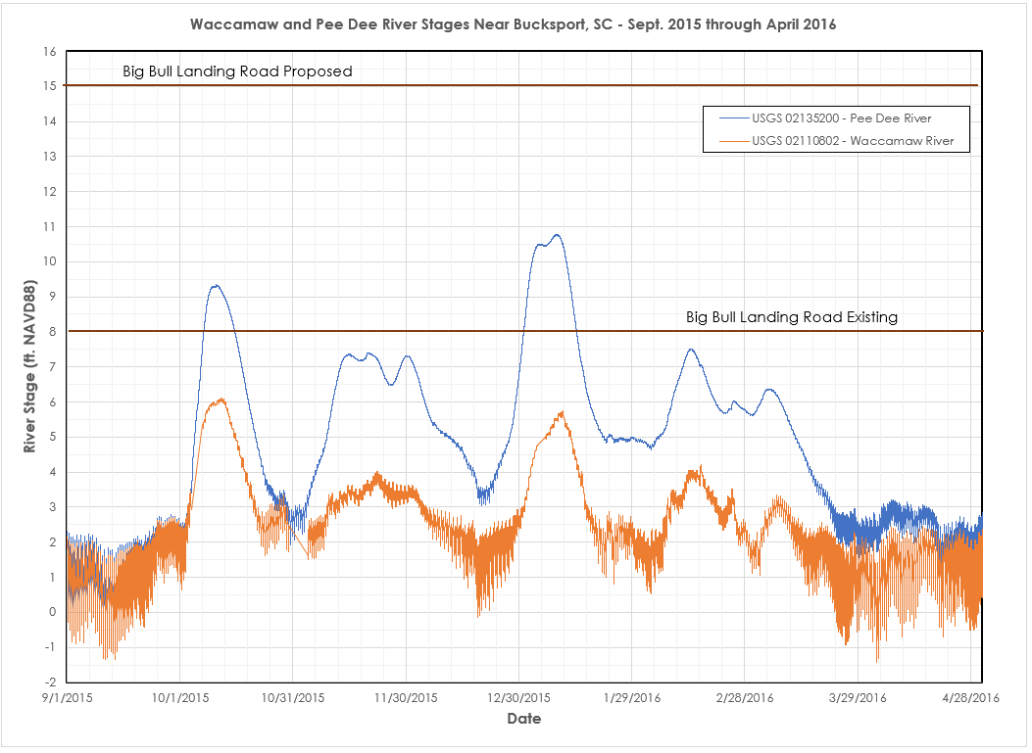
Notes:
Hurricane Joaquim
“1000-yea flood”
Rick Karkowski

Slide 26
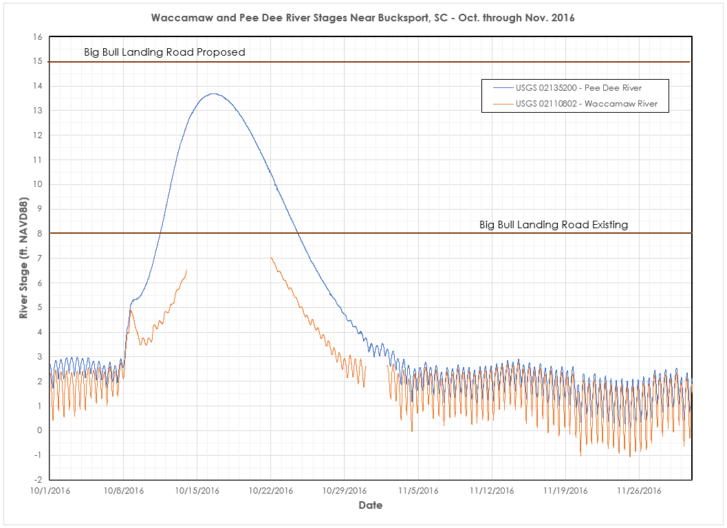
Notes:
Hurricane Matthew
Waccamaw River gage was damaged/did not function for a portion of the event
Rick Karkowski

Slide 27
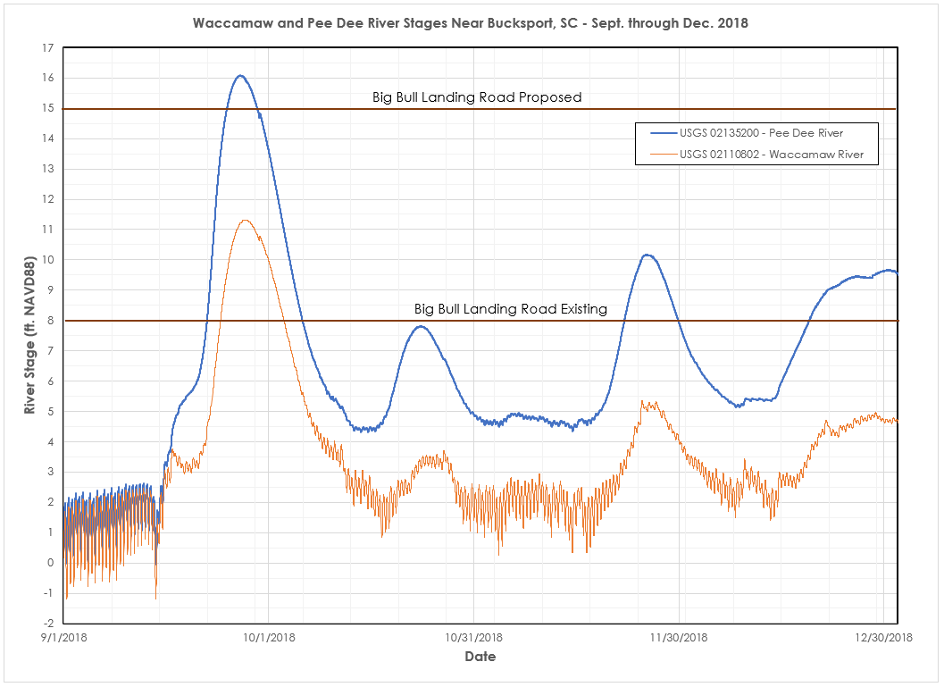
Notes:
Hurricane Florence
Proposed project would have been overtopped
Rick Karkowski

Slide 28
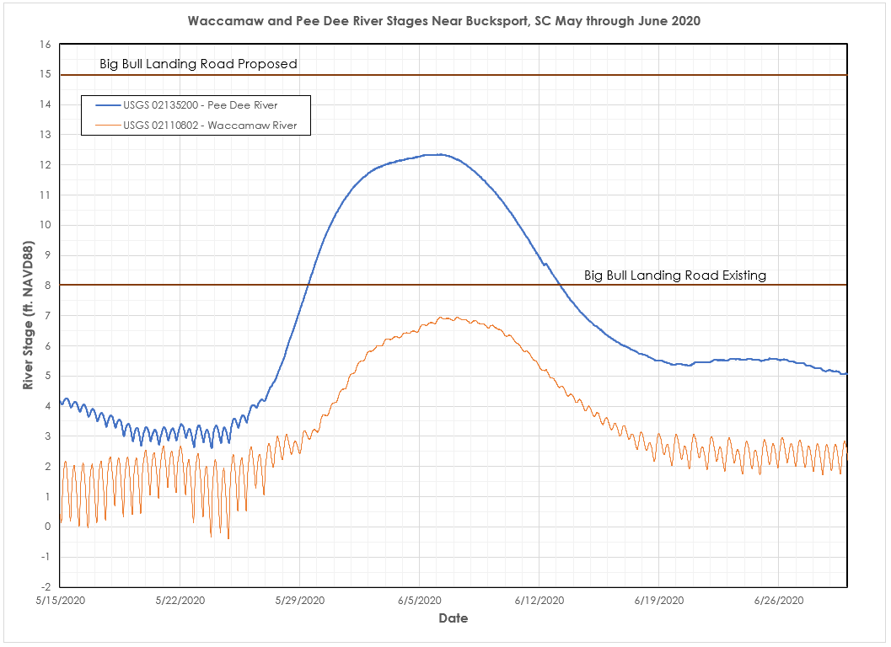
Notes:
Hurricane Bertha
Did not model
Rick Karkowski

Slide 29
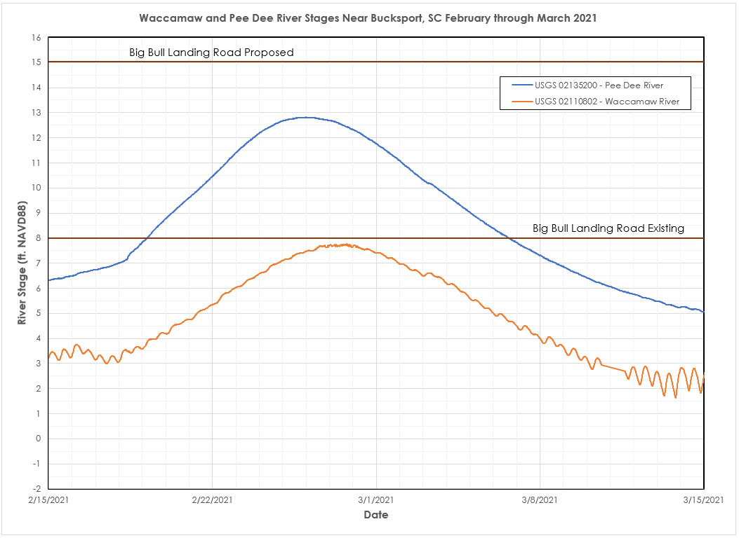
Notes:
Not a hurricane event – extreme rainfall in Pee Dee and Waccamaw watersheds
Did not model
Rick Karkowski

Slide 30
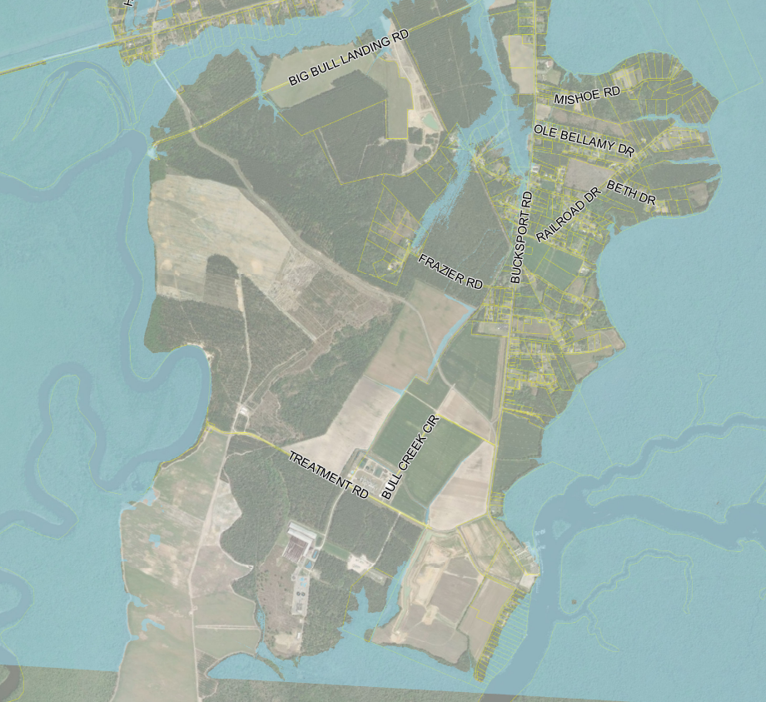
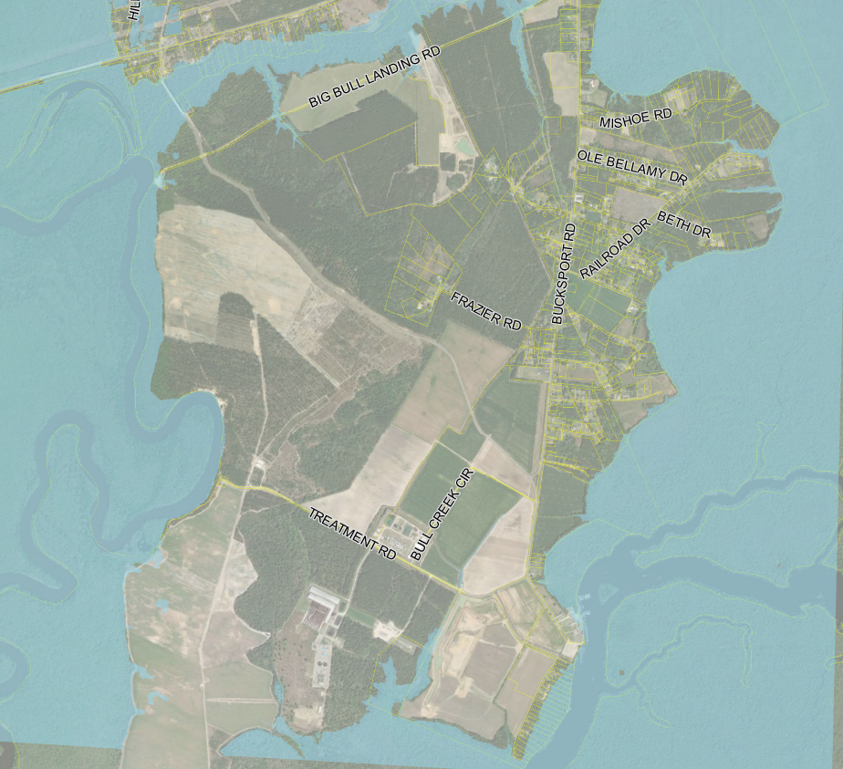
2015 (H. Joaquin) Flooding Extents
Bucksport Area
Pre-Project (Existing)
Post-Project
Notes:
Rick Karkowski

Slide 31
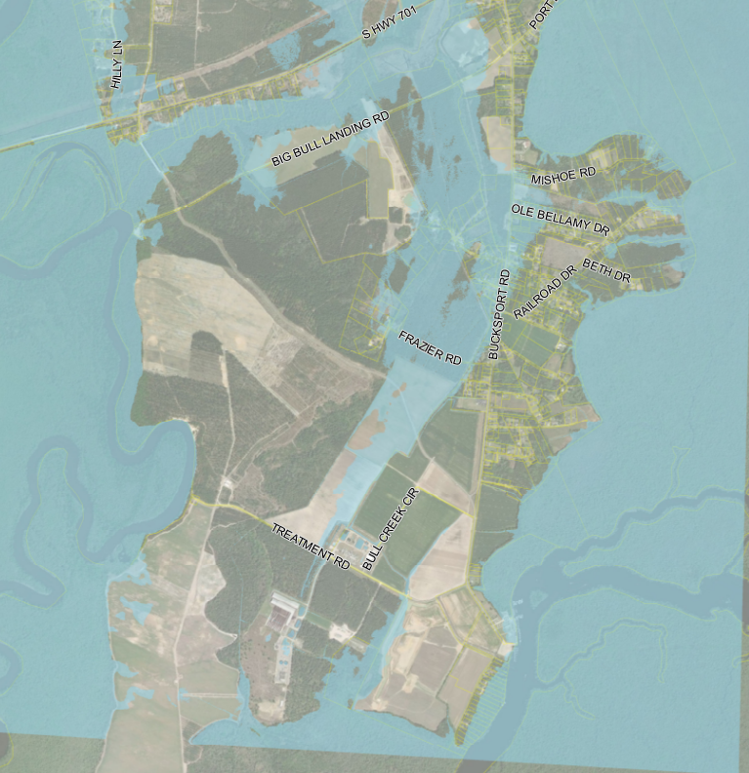
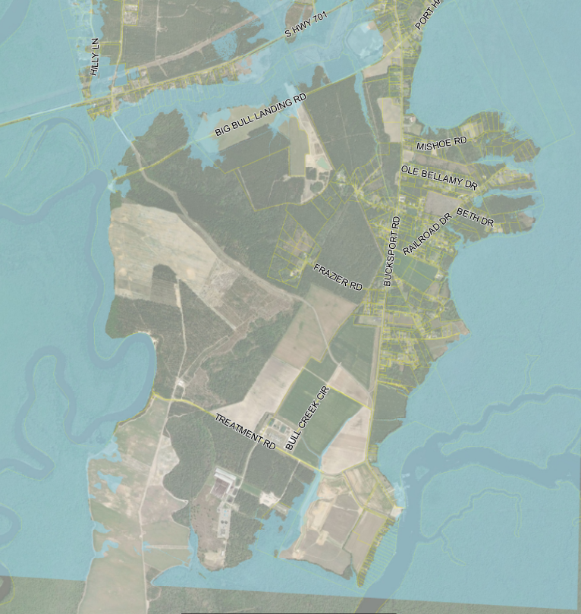
2016 (H. Matthew) Flooding Extents
Bucksport Area
Pre-Project (Existing)
Post-Project
Notes:
Rick Karkowski

Slide 32
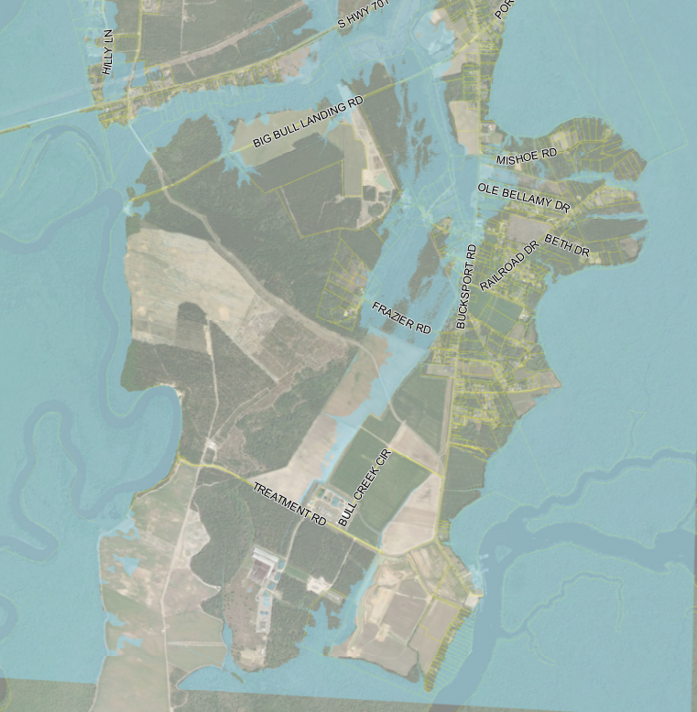
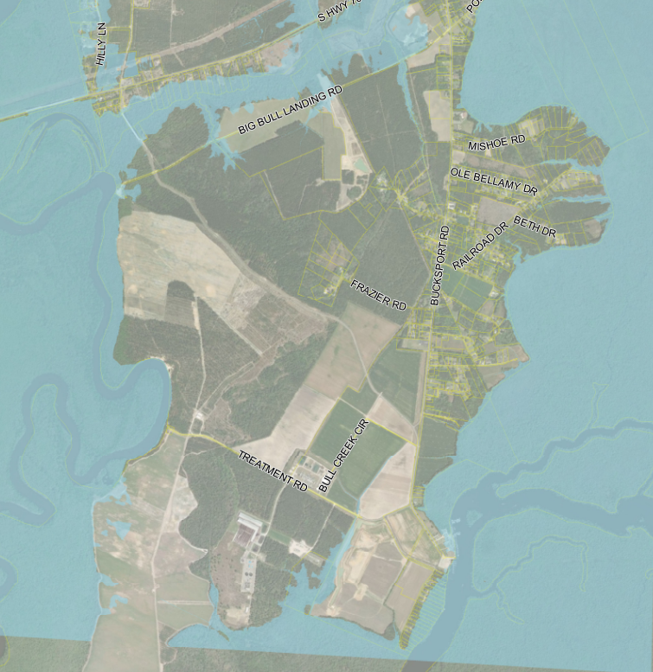
2021 Flooding Extents
Bucksport Area
Pre-Project (Existing)
Post-Project
Notes:
Rick Karkowski

Slide 33
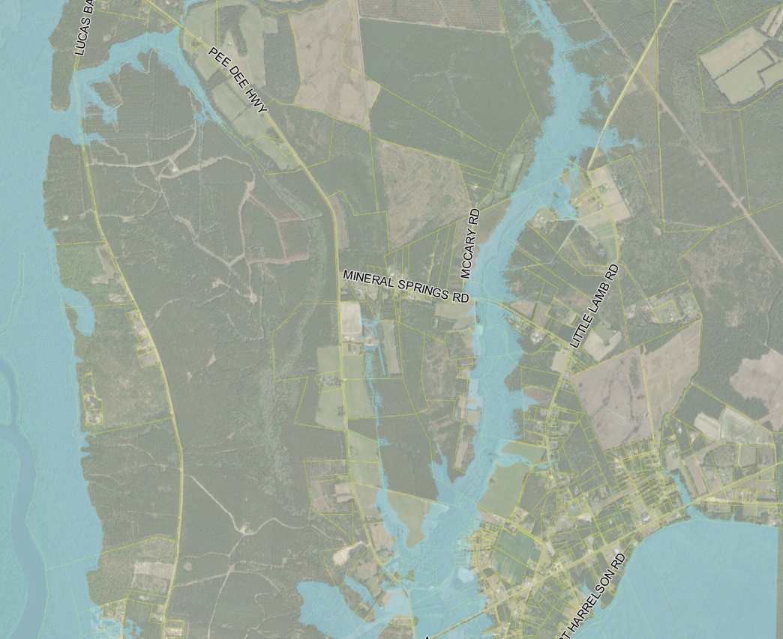
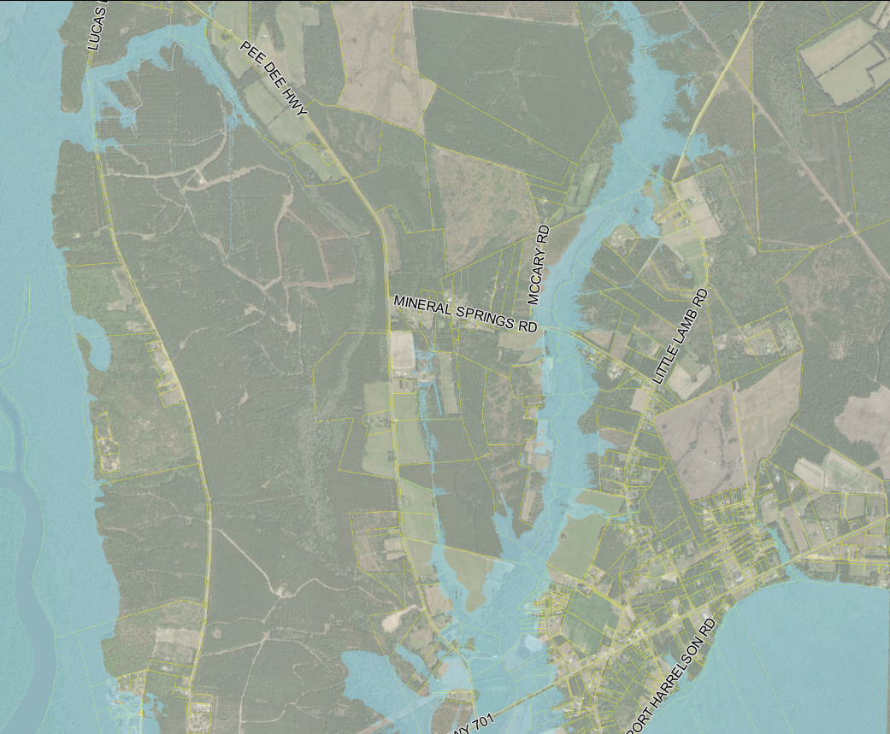
2016 (H. Matthew) Flooding Extents
Little Lamb Area
Pre-Project (Existing)
Post-Project
Notes:
Rick Karkowski

Slide 34
Design Features
Addresses Pee Dee River Backwater Flooding
Only Fully Operational During Pee Dee Backwater Flood Events – Requires County Mobilization Prior to the Event
Added Big Bull Landing Culvert Capacity to Account for Potential Lost Overtopping Capacity
Bucksport Road By-Pass Channel is for Emergency By-Pass Capacity Only (Will Not Introduce Waccamaw River Flow into Cowford Swamp)
Maintain Local Drainage Patterns
Maintain Cowford Swamp Tributary Flow Patterns (Except in Pee Dee River Backwater Flooding Event)
Model Study Demonstrates No Negative Impacts North of Big Bull Landing
Will Not Alter Water Quality
Notes:
Rick Karkowski

