Slide 1
Horry County HOME Consortium
HOME Application Workshop
2023-2024

Slide 2
HOME
U.S. Department of Housing and Urban Development (HUD) provides annual HOME Program funding to the Horry County HOME Consortium.
Created under Title II of the Cranston-Gonzalez National Affordable Housing Act of 1990
Codified at 24 CFR Part 92

Slide 3
Horry County HOME Consortium
Created in 2017, consists of Horry County, Georgetown County, Williamsburg County, and the following municipalities:
  Atlantic Beach
  Aynor
  Conway
  Myrtle Beach
  Loris
  Andrews
  Georgetown
  Greeleyville
  Hemingway
  Kingstree
  Lane
  Stuckey

Slide 4
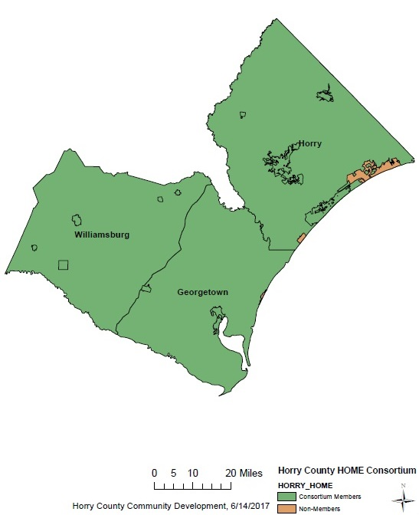
Horry County HOME Consortium

Slide 5
Annual Funding Allocation
2023 Horry County HOME Consortium allocation:
  HOME – $1,239,530
Notes:
$7,966,529

Slide 6
Funding Limitations
Housing Benefit for LMI Households
CHDO Reserve
  15% of the total grant set aside for CHDO projects
Administration Funds
  Capped at 10% of the total grant
Timeliness Monitored by HUD
  4 years to complete projects
  5 year expenditure deadline

Slide 7
Community Needs
HOME activities must be eligible under 24 CFR 92.
All projects must fulfill needs as identified through:
  A 5-Year Consolidated Plan (2018-2022 Consolidated Plan)
  (See Community Development page at https://www.horrycounty.org/Departments/CDBG)
  Results of a Citizen Participation Process, required by HUD
    Public Notices, Public Hearings (Needs Assessment and Action Plan Input), & Community Meetings
    Feedback (Council, Residents, HUD,
    & Subrecipients)
Source: U.S. Department of Housing and Urban Development www.hud.gov

Slide 8
Eligible Activities
Eligible activities include:
Homeowner Rehabilitation
New Homeowner Construction
Tenant Based Rental Assistance
Rental Acquisition & Rehabilitation
Rental New Construction
  Note: Red font denotes requested project types under current solicitation
  Rental projects will be solicited at a later date through a separate process
Source: U.S. Department of Housing and Urban Development www.hud.gov

Slide 9
Homeowner Rehabilitation
Repair of existing housing to code
  The entire HOME unit must be brought up to code
Housing must be occupied by the owner of record on the deed
Household must be 80% AMI or below to qualify
A restrictive covenant and promissory note are placed on the property to ensure affordability
  <$50,000 in repairs, 10 years
  $50,000-$99,999 in repairs, 15 years

Slide 10
Homeowner New Construction
Construction of new housing for ownership
Housing is constructed and sold to an income eligible household.
Household must be 80% AMI or below to qualify.
A restrictive covenant and promissory note are placed on the property to ensure affordability.
  <$15,000 in repairs, 5 years
  $15,000-$40,000, 10 years
  >$40,000, 15 years

Slide 11
Tenant Based Rental Assistance
Rental assistance voucher for a household
TBRA funds the gap between what a household can afford to pay and local rent standards.
Assistance moves with the household from unit to unit.
Households must be 60% AMI or below.
No affordability period is applicable.
Security deposits and utility deposits
may also be funded.
  Note: utility deposit assistance may not be
  provided as a stand-alone program.

Slide 12
HOME Income Limits
Household Income Limit | 1 Person | 2 Person | 3 Person | 4 Person | 5 Person | 6 Person | 7 Person | 8 Person
Horry County
Extremely Low Income (30%) | $15,200 | $17,400 | $19,550 | $21,700 | $23,450 | $25,200 | $26,950 | $28,650
Very Low Income (50%) | $25,350 | $28,950 | $32,550 | $36,150 | $39,050 | $41,950 | $44,850 | $47,750
60% Limit | $30,420 | $34,740 | $39,060 | $43,380 | $46,860 | $50,340 | $53,820 | $57,300
Low Income (80%) | $40,500 | $46,300 | $52,100 | $57,850 | $62,500 | $67,150 | $71,750 | $76,400
Georgetown County
Extremely Low Income (30%) | $15,550 | $17,750 | $19,950 | $22,150 | $23,950 | $25,700 | $27,500 | $29,250
Very Low Income (50%) | $25,900 | $29,600 | $33,300 | $36,950 | $39,950 | $42,900 | $45,850 | $48,800
60% Limit | $31,080 | $35,520 | $39,960 | $44,340 | $47,940 | $51,480 | $55,020 | $58,560
Low Income (80%) | $41,400 | $47,300 | $53,200 | $59,100 | $63,850 | $68,600 | $73,300 | $78,050
Williamsburg County
Extremely Low Income (30%) | $13,100 | $14,950 | $16,800 | $18,650 | $20,150 | $21,650 | $23,150 | $24,650
Very Low Income (50%) | $21,800 | $24,900 | $28,000 | $31,100 | $33,600 | $36,100 | $38,600 | $41,100
60% Limit | $26,160 | $29,880 | $33,600 | $37,320 | $40,320 | $43,320 | $46,320 | $49,320
Low Income (80%) | $34,850 | $39,800 | $44,800 | $49,750 | $53,750 | $57,750 | $61,700 | $65,700
Source: 2023 Adjusted HOME Income Limits, HUD (effective 6/15/2023)
Note: HOME income limits are released on an annual basis, typically in June. HCHC will provide updated income limits when available.

Slide 13
Ineligible Activities/Fees 24 CFR 92.214
Ineligible items include:
Project reserve accounts/operating subsidies
TBRA for an existing Section 8 program
Prepayment of low income housing mortgages
Projects previously funded with HOME funds during the affordability period
Property acquired in anticipation of a project
Delinquent taxes, fees, or charges
Source: U.S. Department of Housing and Urban Development www.hud.gov

Slide 14
Match
Eligible Match Sources (25% required):
  Cash or cash equivalents (non-federal)
  Waived taxes, fees, or charges
  Value of donated land or real property
  Cost of infrastructure improvements
  Donated materials, equipment, labor, and professional services
  Direct costs of supportive services to residents of HOME projects
  Homebuyer counseling for families purchasing homes with HOME assistance
  Housing bonds
  Sweat equity

Slide 15
CHDO Certification Application
Community Housing Development Organization:
  A private nonprofit, community-based, service organization that has, or intends to obtain, staff with the capacity to develop affordable housing for the community it serves.
Organization will act as an owner, developer, or sponsor of a CHDO project
  Developer role only for Homeowner New Construction
  Homeowner rehabilitation and TBRA are not eligible for funding through CHDO set-aside funds.
Special qualifications for certification
  See separate CHDO certification application

Slide 16
CHDO Operating Assistance
A CHDO can apply for operating assistance
Eligible expenses include:
  Salaries, wages, and benefits
  Employee education, training, and travel
  Rent and utilities
  Communication costs
  Technical assistance
  Contracted professional services (not project specific)
  Taxes and insurance
  Equipment, materials, and supplies
Please see CHDO operating application

Slide 17
Common Mistakes or Issues
Incomplete Application
Ineligible Activity
Financial Statements “Don’t Add Up”
Non-Profit Does Not Show Capacity or Ability to Cash Flow
Project Located in Ineligible Jurisdiction
Lack of Experience with Proposed Activity
No Match – 25% match required

Slide 18
Process and Tentative Timeline
Deadline for Questions: July 17, 2023 (5 PM)
Application Deadline: July 24, 2023 (5 PM)
Staff may follow up with questions about your project

Slide 19
Additional Information
More information is available online on the Horry County Community Development website at:
https://www.horrycountysc.gov/departments/community-development/grants/housing/home/
The Community Development web page provides helpful links, such as:
    Application forms (Word/Excel)
    Program Limits (Income, Rent, etc.)
    Consolidated Plan (2018-2022)
    Assessment of Fair Housing

Slide 20
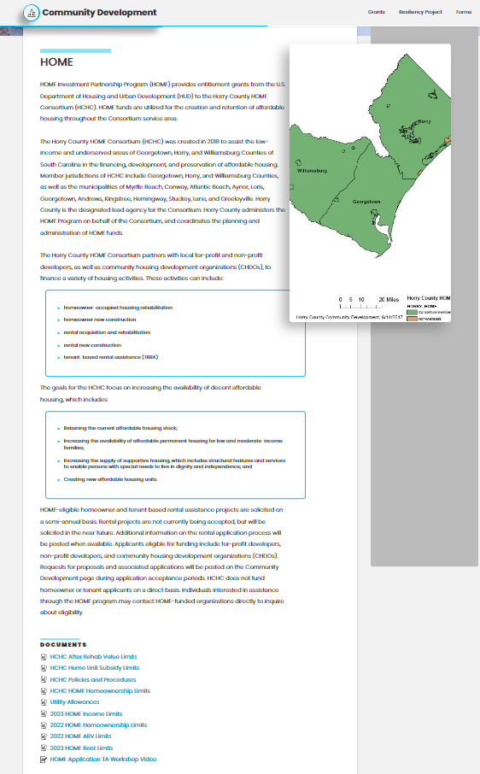
Application and Resource
Location

Slide 21
Contact Information
  Horry County Community Development
  100 Elm Street
  Conway, SC 29526
  (843) 915-7033
  Griffin.Jennifer@horrycountysc.gov
  Please submit questions through email.
  Answers will be published as addenda.

